Slide 1




c r e a t e . t h e n ( P l a y . t h e n (
@cmetgamesdev

Slide 2
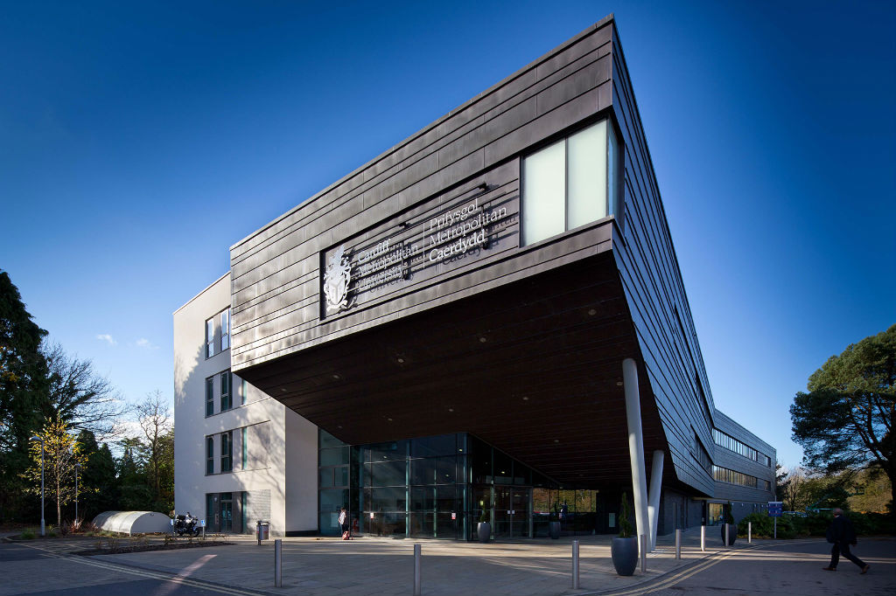
WE ARE
#CARDIFFMET
Welcome to Cardiff Metropolitan University and the Cardiff School of Technologies

Slide 3
Meet the Team…
Paul Angel
Head of Department – Computer Science
Programme Director - Computer Games Development
Catherine Tryfona
Head of Department – Engineering Applications
Programme Director – Computer Science, Software Engineering, Business Info Systems
Glenn Jenkins
Senior Lecturer – Computer Games Development
Jason Williams
Deputy Dean, Cardiff School of Technologies

Slide 4
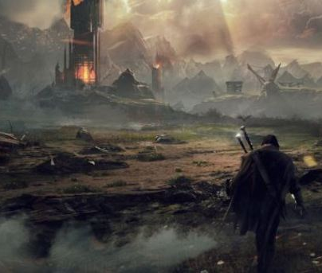
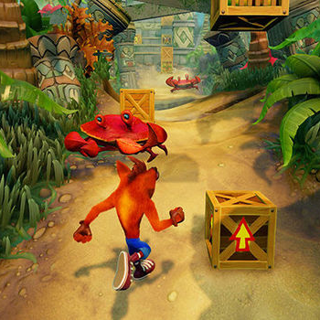
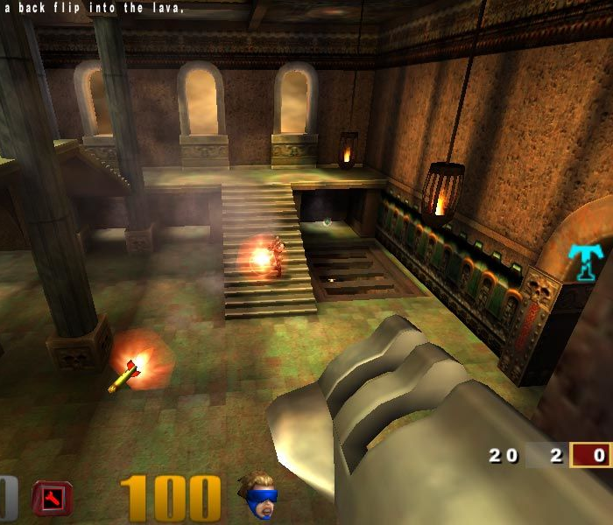
What makes a good game?
…Games that are fun and rewarding to play!
…Games that appeal to your players!

Slide 5
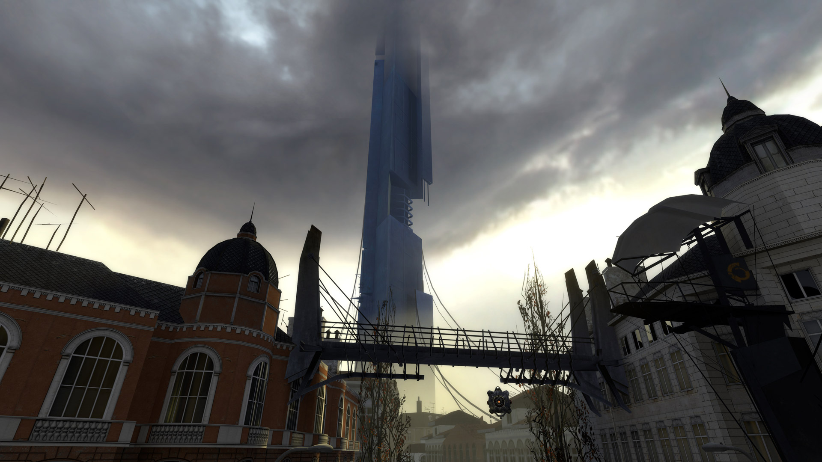

Slide 6
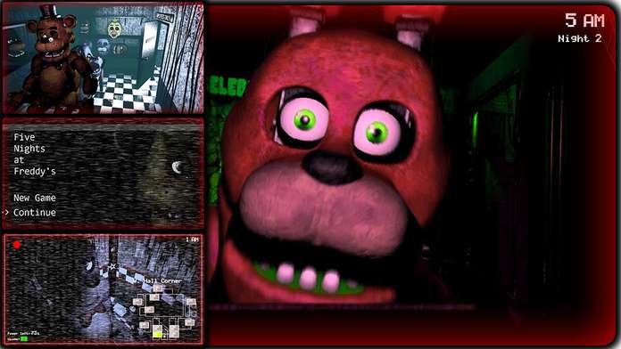

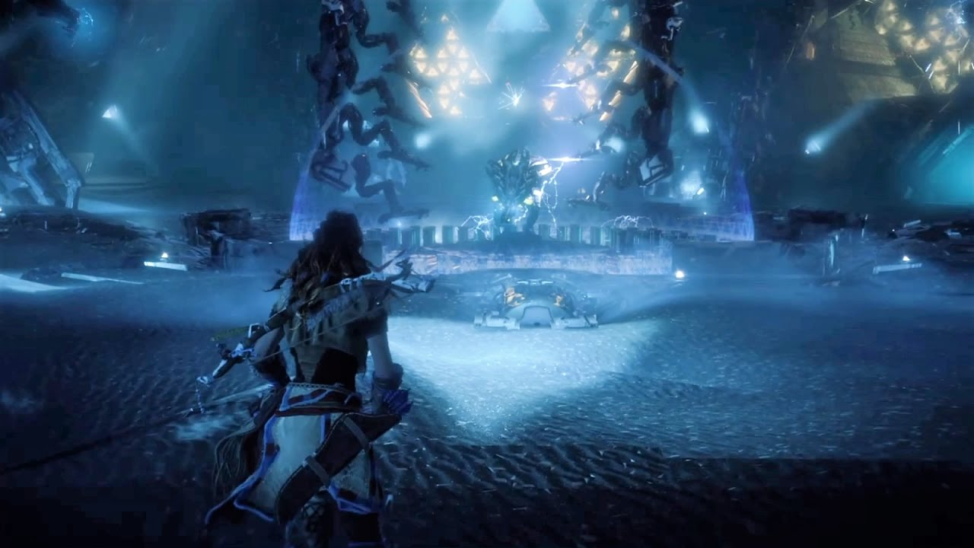
What makes a good game?
...Games that get the pacing right!
...Games that are believable and immerse your player

Slide 7
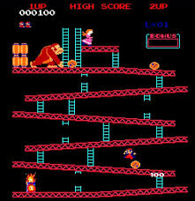
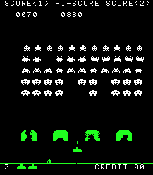
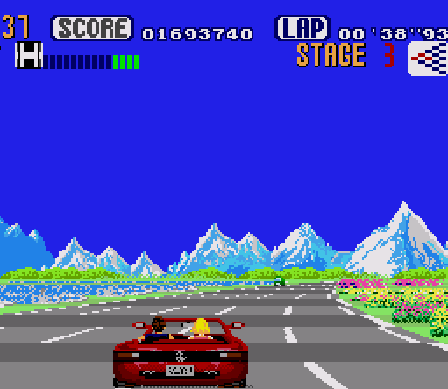
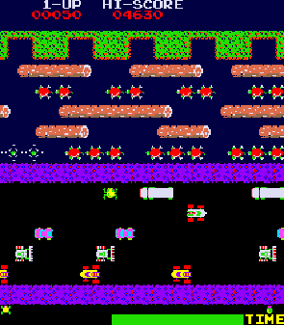
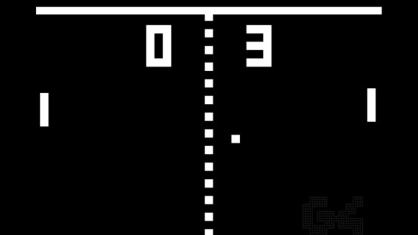
Where we’ve been!

Slide 8
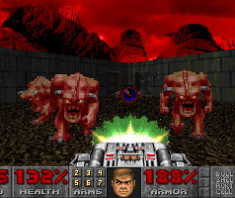
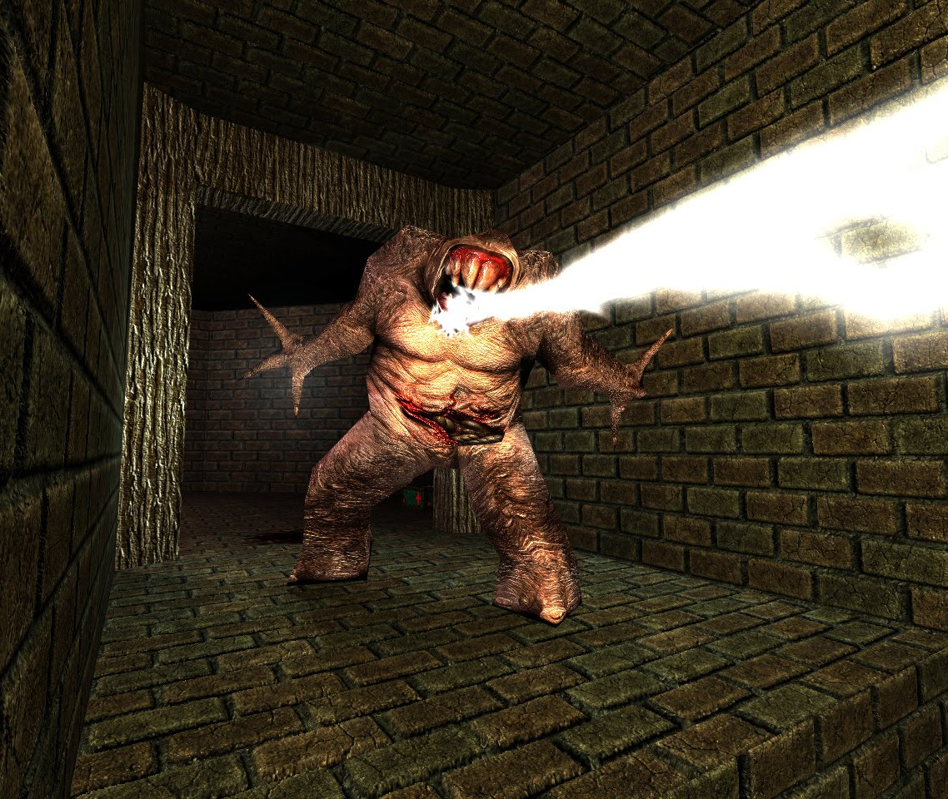
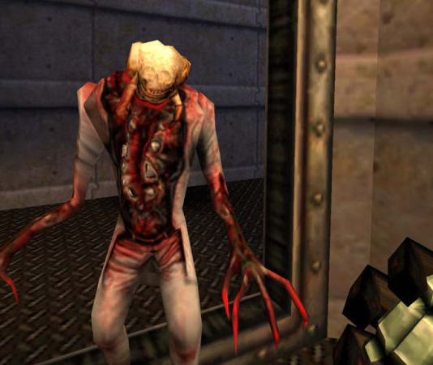

Slide 9

Where we’re going!

Slide 10
Plan for the week…
Date | 9.15am | 9.30am – 10.30am | 10.30am – 11.30am | 11.30am – 12.30pm | 12.30pm – 1.30pm | 1.30pm – 2.30pm | 2.30pm – 4pm
Monday 8th April 2019 | Meet at CSM reception – Llandaff campus | Registration & Welcome | Group work Lecture Paul Angel; Glenn Jenkins O016 | Group work Lecture Paul Angel; Glenn Jenkins O016 | LUNCH | Group work Lecture Paul Angel; Glenn Jenkins O016 | Group work Lecture Paul Angel; Glenn Jenkins O016
Tuesday 9th April 2019 | Meet at CSM reception | Project work Paul Angel O208 Glenn Jenkins O119 Cath Tryfona O306 | Project work Paul Angel O208 Glenn Jenkins O119 Cath Tryfona O306 | Project work Paul Angel O208 Glenn Jenkins O119 Cath Tryfona O306 |  | Project work Paul Angel O208 Glenn Jenkins O119 Cath Tryfona O306 | Project work Paul Angel O208 Glenn Jenkins O119 Cath Tryfona O306
Wednesday 10th April 2019 | Meet at CSM reception | St Fagans 10.30 pick up until 2pm |  |  |  | St Fagans
Thursday 11th April 2019 | Meet at CSM reception | Project work Paul Angel O208 Glenn Jenkins O119 Cath Tryfona O306 | Project work Paul Angel O208 Glenn Jenkins O119 Cath Tryfona O306 | Project work Paul Angel O208 Glenn Jenkins O119 Cath Tryfona O306 |  | Project work Paul Angel O208 Glenn Jenkins O119 Cath Tryfona O306 | Project work Paul Angel O208 Glenn Jenkins O119 Cath Tryfona O306
Friday 12th April 2019 | Meet at CSM reception | Poster Presentations Project work Paul Angel O208 Glenn Jenkins O119 Cath Tryfona O306 | Presentations O216 O320 | Certificate presentations O320

Slide 11
Your project for the week…
What we want to do…
Explore both the creative and technical side of game development – develop a sprite-based web game.

Slide 12
Game Brief
For this project you’re required to work in teams to design and develop a 2D web-based game. The theme of the game is left for you to decide – use your imaginations!
In your teams, design your games, levels and sprites. Using JavaScript, implement your ideas.
Three starting-points are given to you – a space shooter, a 2-player racing game and a platform engine prototype. These are available to download from bitbucket.
git clone https://pnangel17@bitbucket.org/pnangel17/explorer1.git
git clone https://pnangel17@bitbucket.org/pnangel17/racer.git
git clone https://pnangel17@bitbucket.org/pnangel17/gocrackers.git

Slide 13
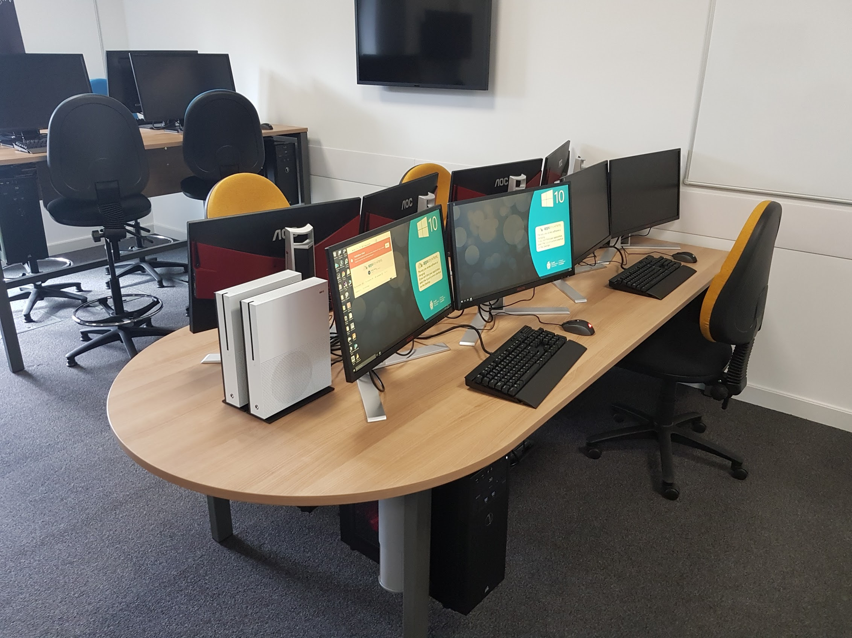
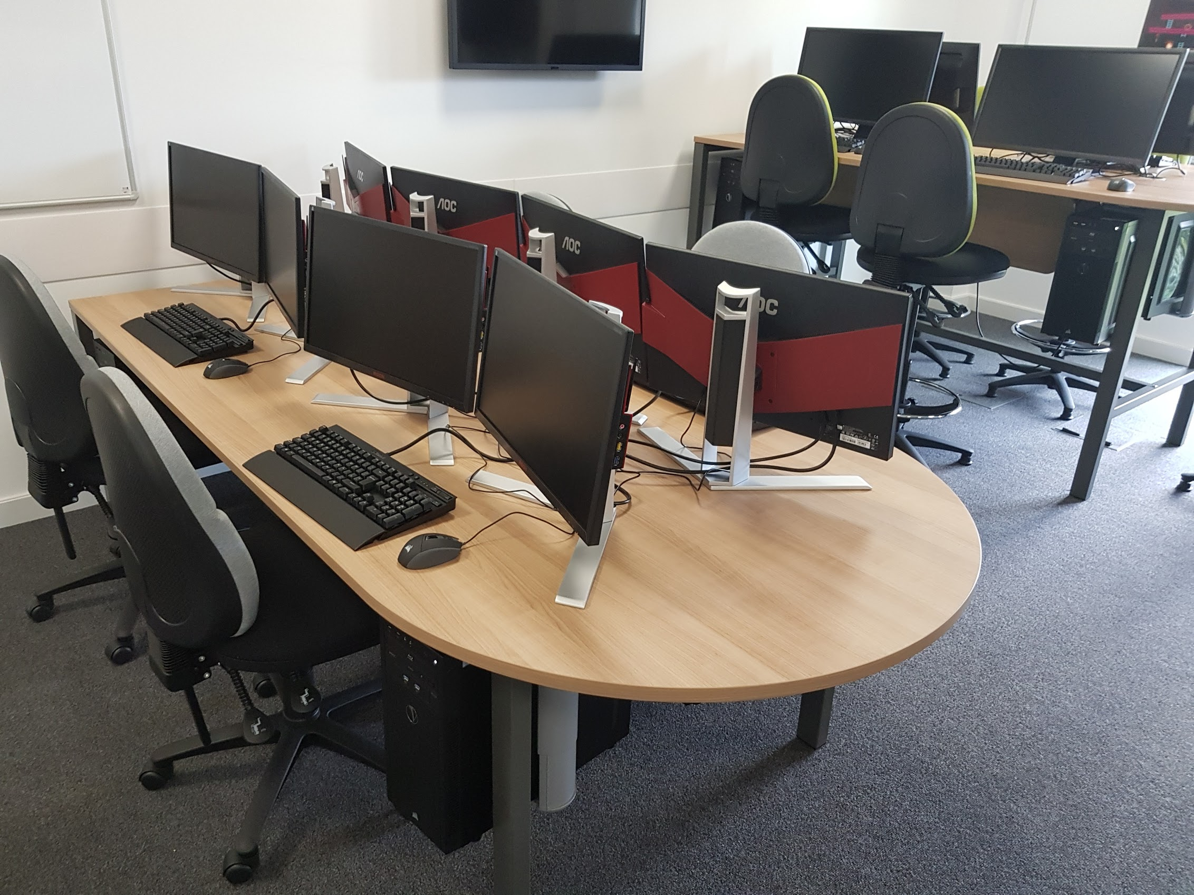
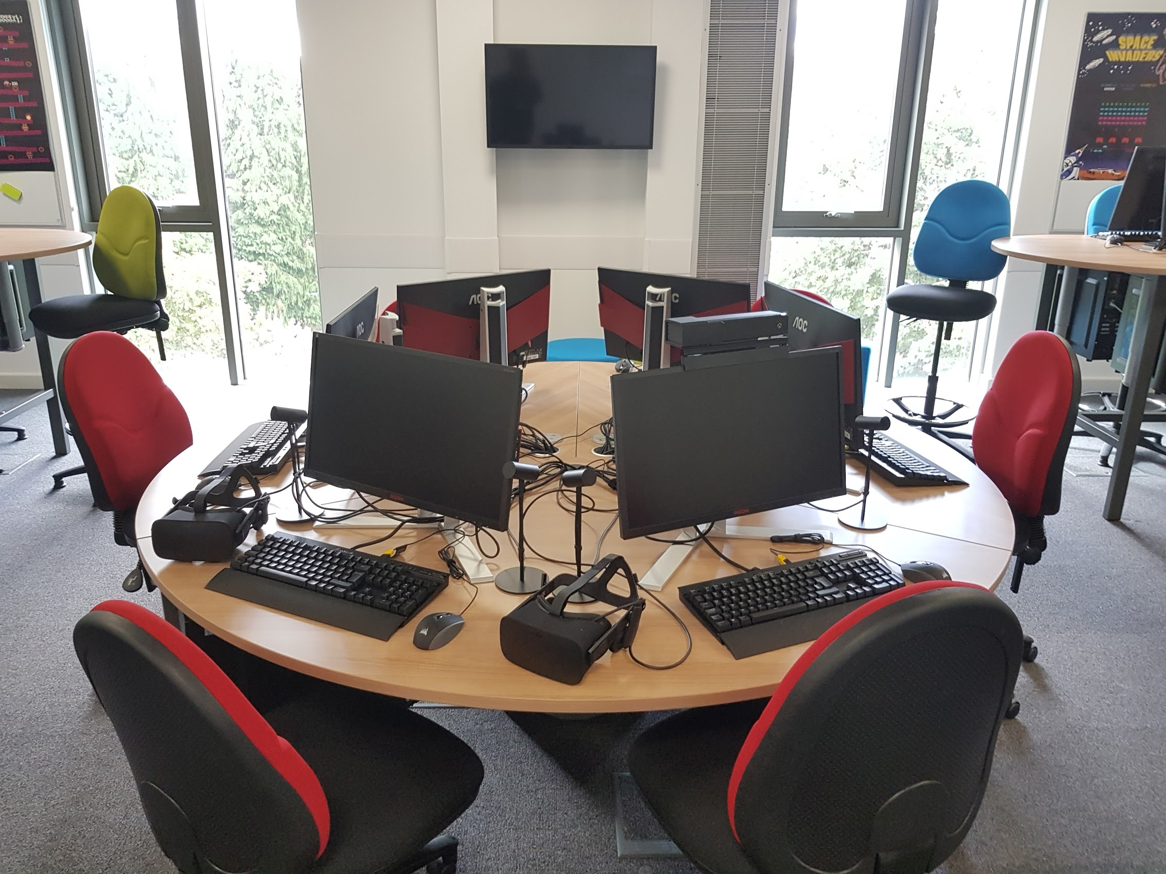
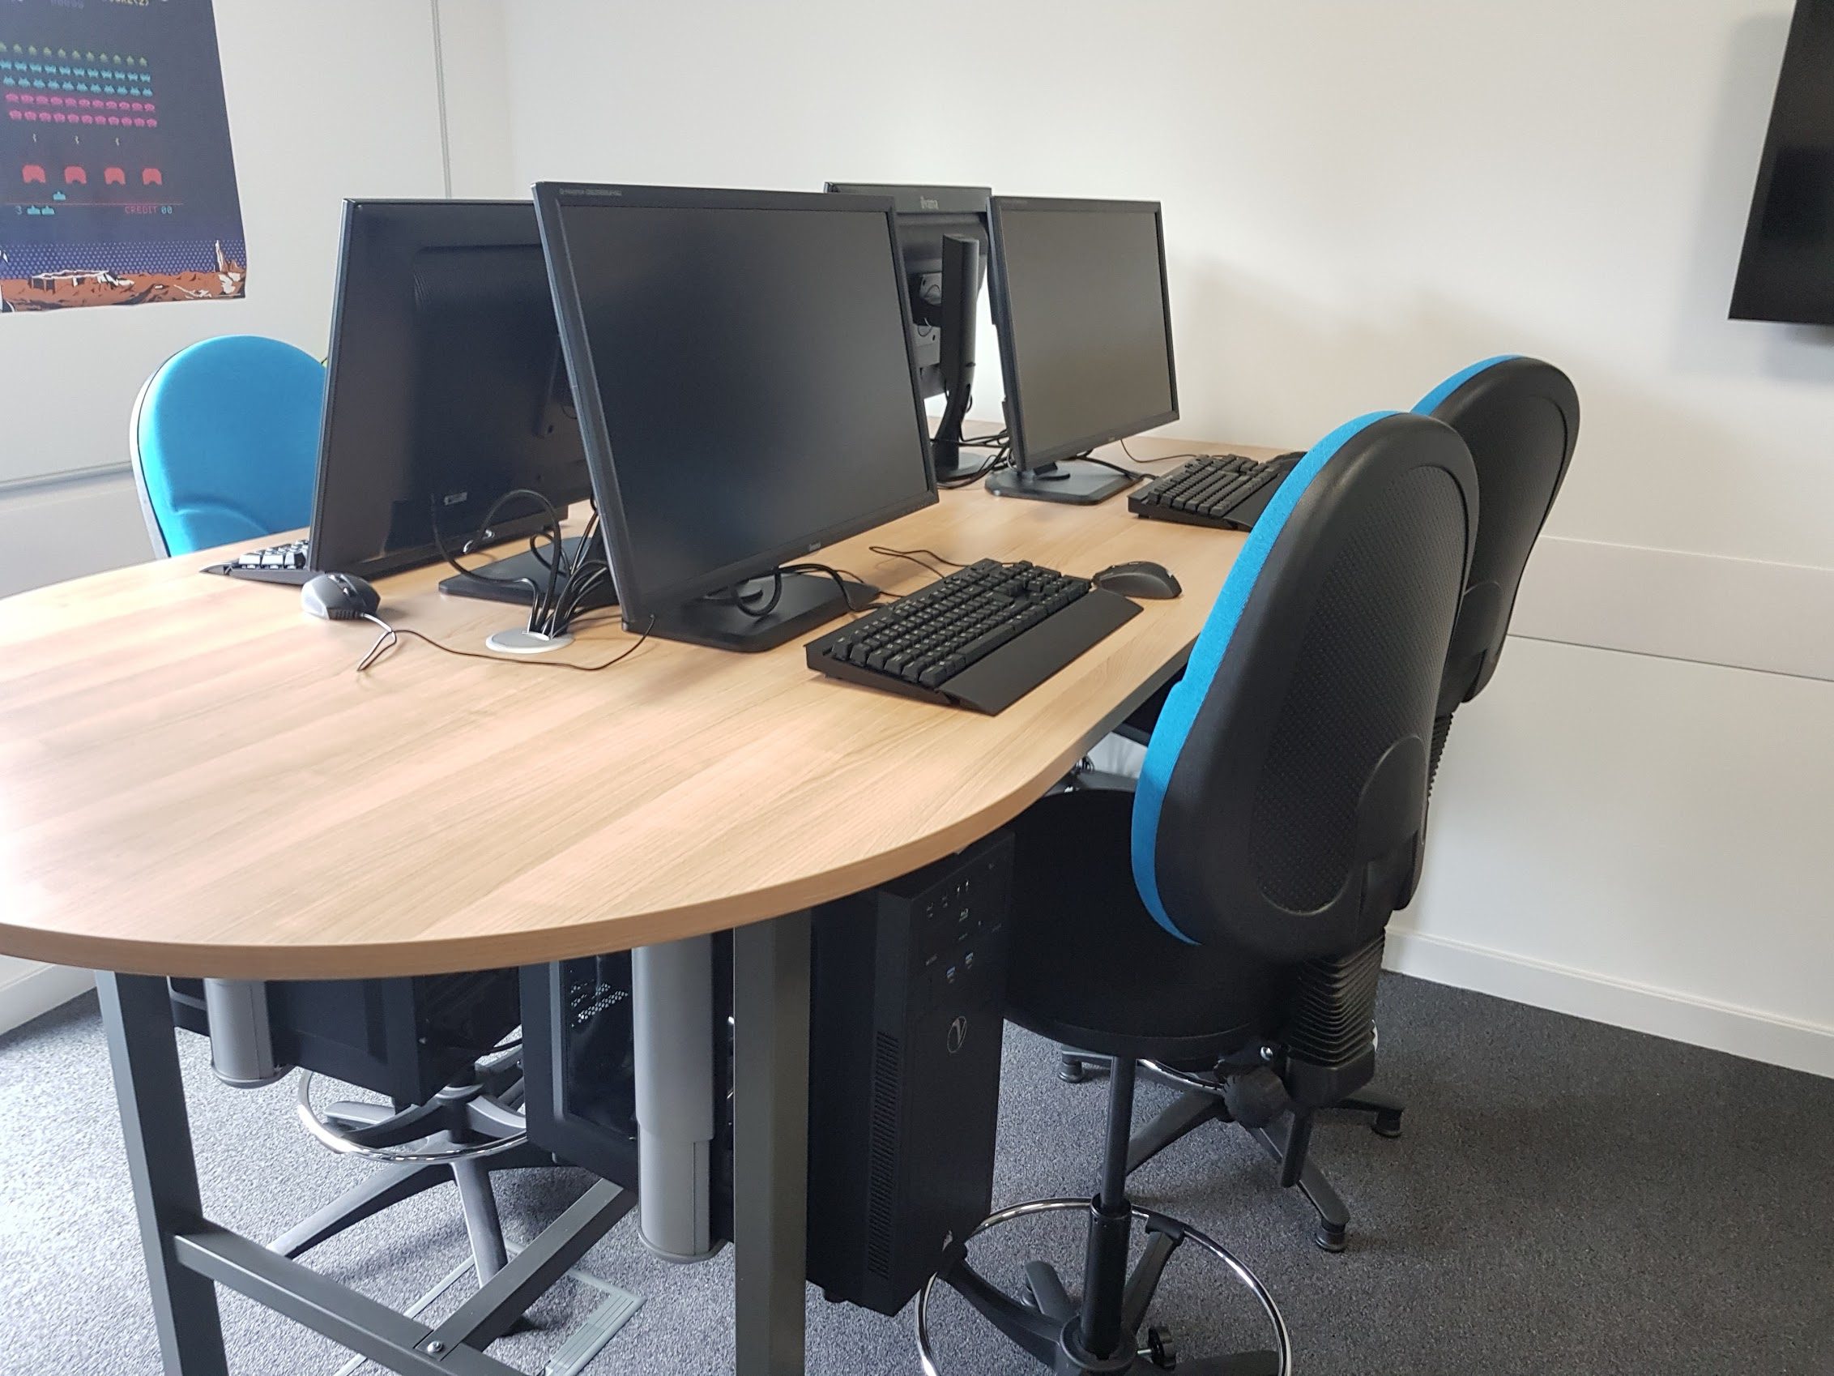
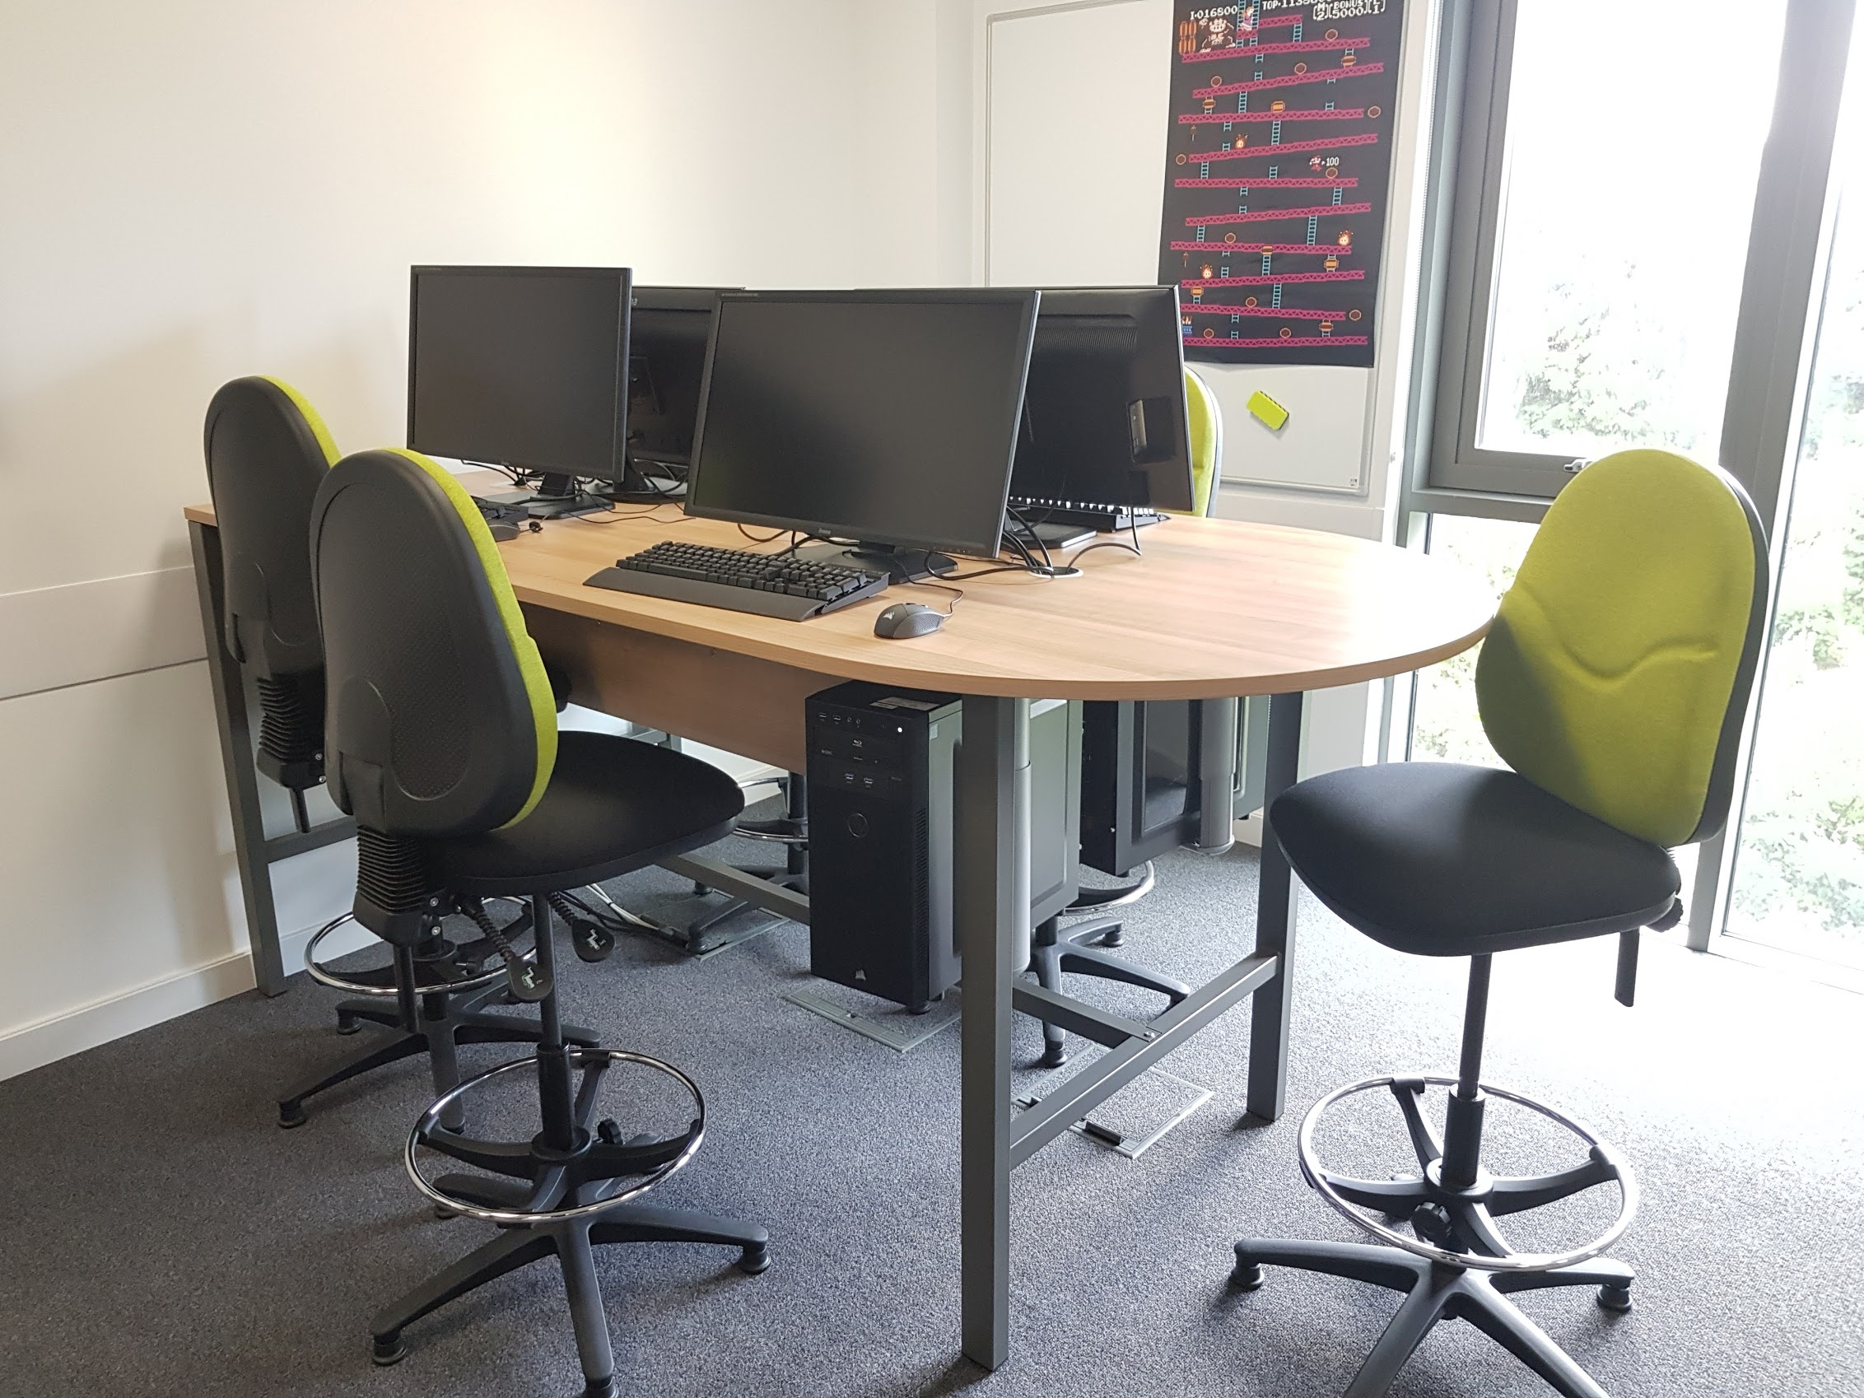
Our Lab…
Dual monitor Workstations (Xbox hub)
Dual monitor Workstations (PS Hub)
VR hub
4K Workstations
4K Workstations

Slide 14
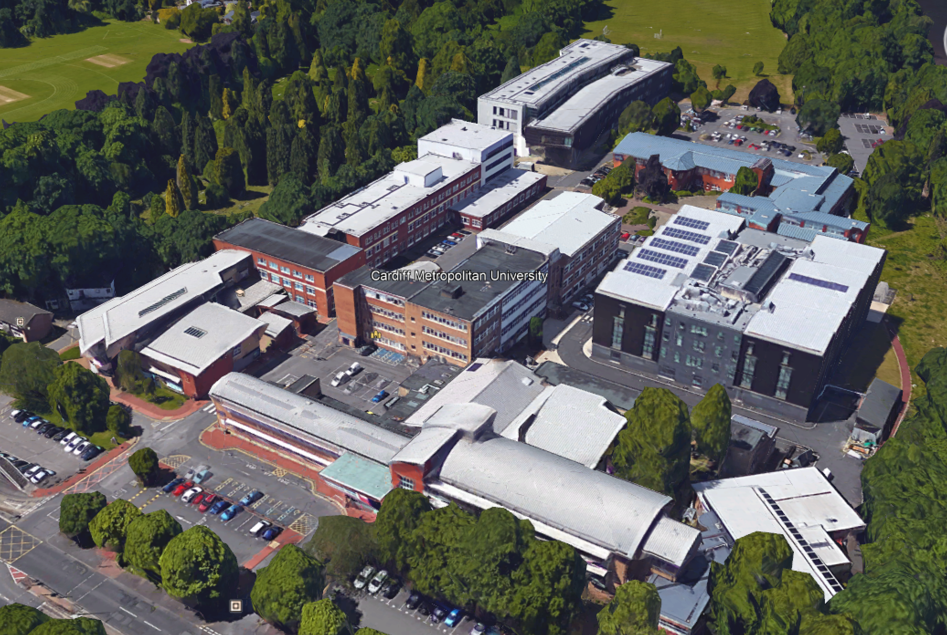





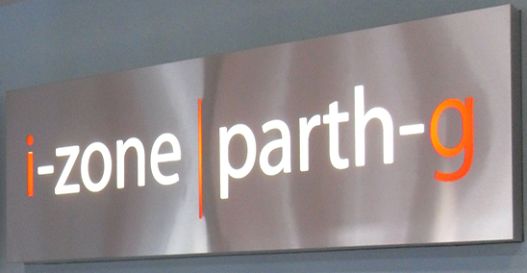
A Quick guide to the campus. What all Computing people need : Coffee + Code
Dedicated Games Development Lab (O3.06)
We’re here – the Cardiff School of Management (CSM) building “O Block”
General Computer Labs (O1.19, O2.19)
IT Suite & General Computer Labs “T Block”
Atrium Café
The Library
“The Box” Café
The Gallery Café
The i-Zone

Slide 15
Any Questions???

